Slide 1
Dynamic Mode Decomposition
Dynamic Mode
Decomposition

Slide 2
Data Driven Dynamical System
Definition :
A Data-Driven Dynamical System (DDDS) is a method used to understand, model, and predict the behavior of complex systems over time by relying on data rather than traditional mathematical equations. In simple terms, instead of manually defining how a system works using physics-based models, we let data reveal the underlying patterns and rules governing the system’s behavior.
Key Idea:
Traditional dynamical systems use mathematical equations (such as differential equations) to describe how a system changes over time.
A data-driven approach uses machine learning, statistics, and pattern recognition to extract system behavior directly from real-world data.
This method is especially useful when the exact mathematical model is unknown or too complex to derive.

Slide 3
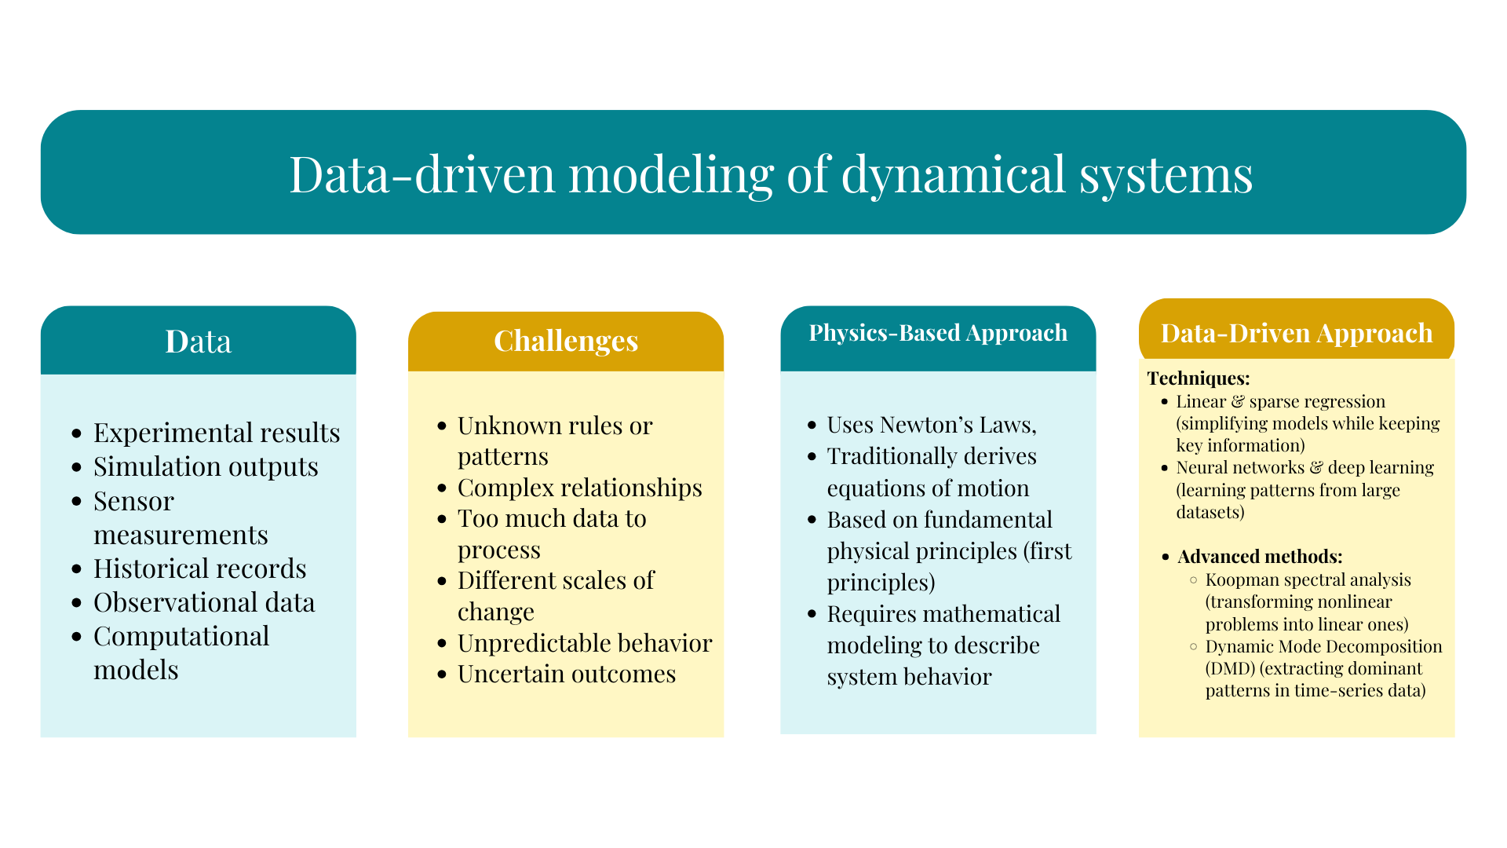

Slide 4
Methods of Data-Driven Dynamical Systems
Dynamic Mode Decomposition (DMD) – Extracts key patterns (modes) from time-series data to analyze system evolution.
Koopman Operator Theory– Transforms nonlinear systems into a linear framework using eigenfunctions, making predictions easier.
Neural Networks & Deep Learning – Uses AI models to learn system behavior from data, useful for complex and nonlinear systems.

Slide 5
Dynamic Mode Decomposition
Definition:
Dynamic Mode Decomposition (DMD) is a data-driven method used to analyze and extract coherent structures* (modes) from high-dimensional dynamical systems*. It is particularly useful for identifying patterns in time-series data, such as fluid flows, climate data, or any system that evolves over time. DMD decomposes the data into a set of modes, each associated with a specific frequency and growth/decay rate, allowing us to understand the underlying dynamics of the system.
Why We Use DMD:
Extract Coherent Structures: DMD helps in identifying dominant patterns (modes) in the data that evolve over time. These modes can represent physical phenomena like vortices in fluid flow or weather patterns in climate data.
Model Reduction: DMD provides a low-dimensional representation* of high-dimensional systems, making it easier to analyze and simulate complex systems.
Predict Future States: Once the modes are identified, DMD can be used to predict the future state of the system by extrapolating the dynamics of the modes.
System Identification: DMD can be used to identify the underlying dynamics of a system, even when the governing equations* are unknown.

Slide 6
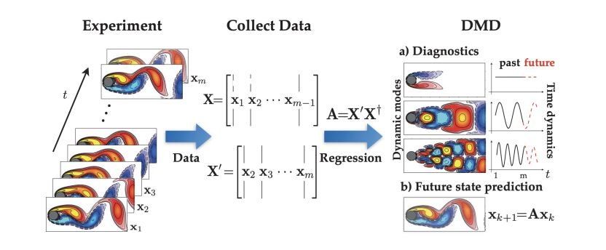
How DMD works :

Slide 7
DMD works by analyzing snapshots of data collected over time. These snapshots are typically high-dimensional (e.g., velocity fields in fluid dynamics or temperature distributions in climate models). The goal is to find a low-dimensional representation of the system that captures its essential dynamics.
Data Collection: Collect a sequence of snapshots (data points) from the system at different times. Let’s denote these snapshots as x₁ , x₂ ,…., x_{m}, where each x_{i} is a high- dimensional vector .
Snapshot Matrices: Arrange the snapshots into two matrices:
X = [ x₁,x₂,……., x_{m-1}]
X’ = [ x₂,x₃,………, x_{m} ]
Here X’ is the time-shifted version of X , meaning that X’ contains the snapshots at the next time step.
3. Linear dynamics assumption: DMD assumes that the dynamics of the system can be approximated by a linear operator A such that:
x_{k+1} = A x_{k}
this means that the system evolves linearly from one snapshot to the next.

Slide 8
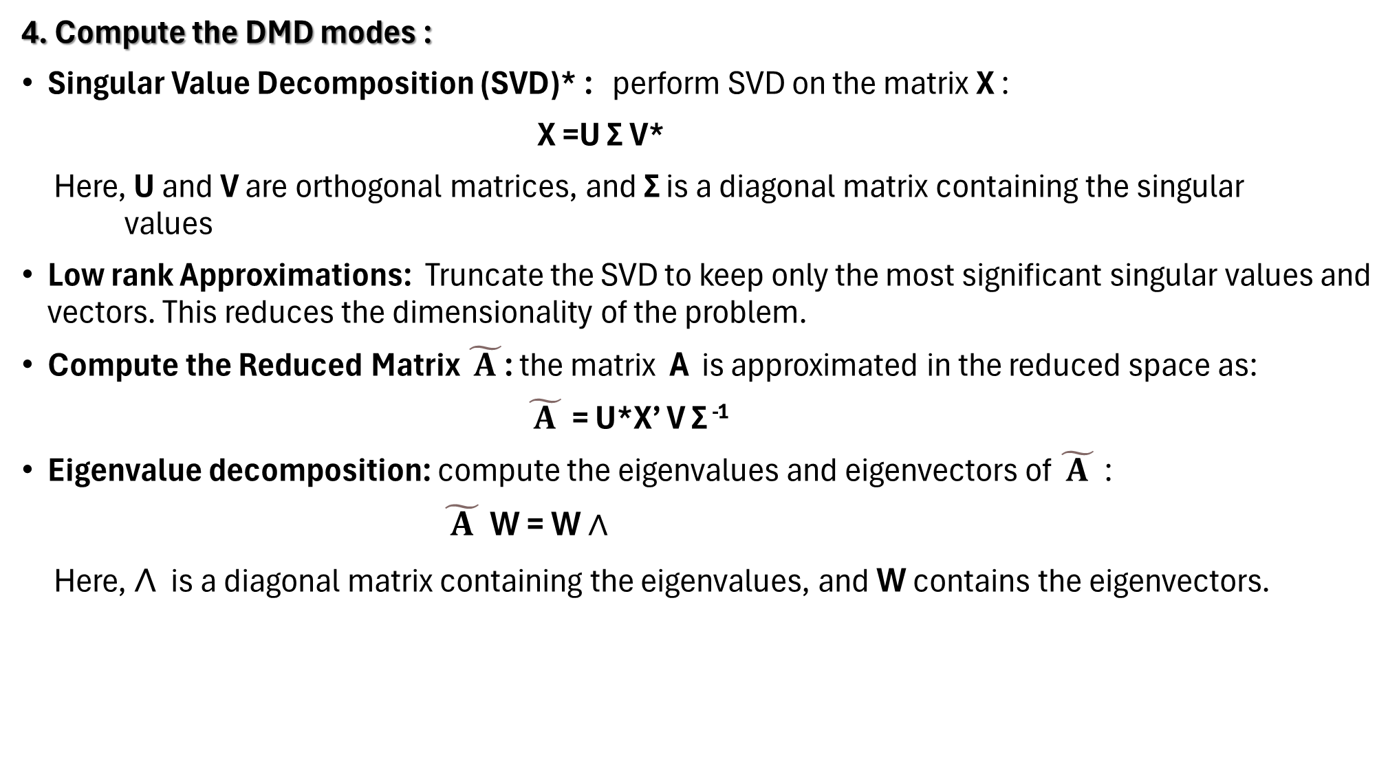
4. Compute the DMD modes :
Singular Value Decomposition (SVD)* : perform SVD on the matrix X :
X =U ΣV*
Here, U and V are orthogonal matrices, and Σ is a diagonal matrix containing the singular values
Low rank Approximations: Truncate the SVD to keep only the most significant singular values and vectors. This reduces the dimensionality of the problem.
Compute the Reduced Matrix $\tilde{ A }$: the matrix Ais approximated in the reduced space as:
$\tilde{ A }$= U*X’ V Σ⁻¹
Eigenvalue decomposition: compute the eigenvalues and eigenvectors of $\tilde{ A }$:
$\tilde{ A }$W = W $∧$
Here, $∧$is a diagonal matrix containing the eigenvalues, and W contains the eigenvectors.

Slide 9

DMD modes: The DMD mode are given by :
$φ=X^{′}VΣ^{−1}W$
Theses modes represent the spatial structures* of the system

Slide 10
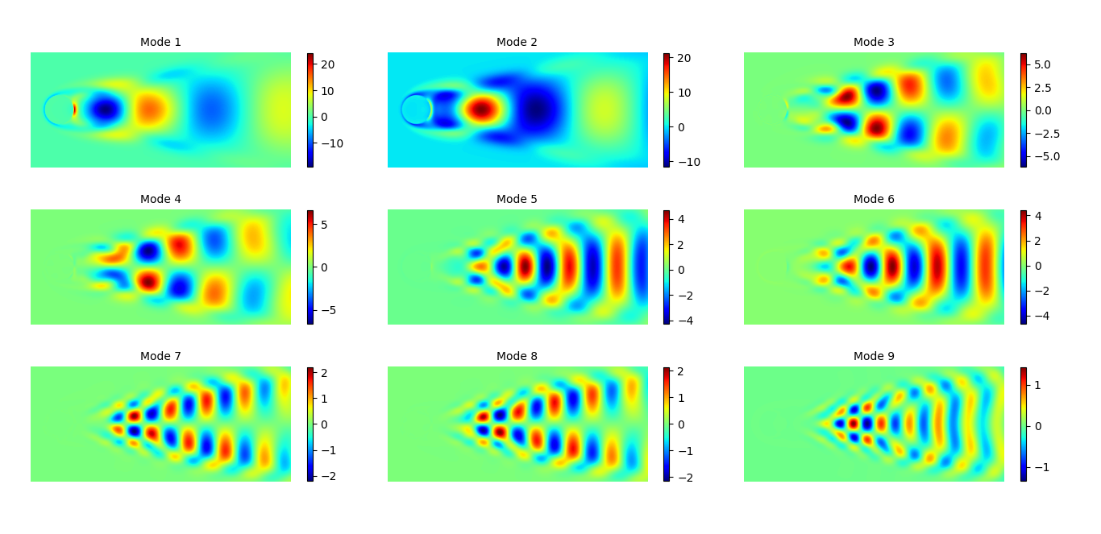
Output

Slide 11
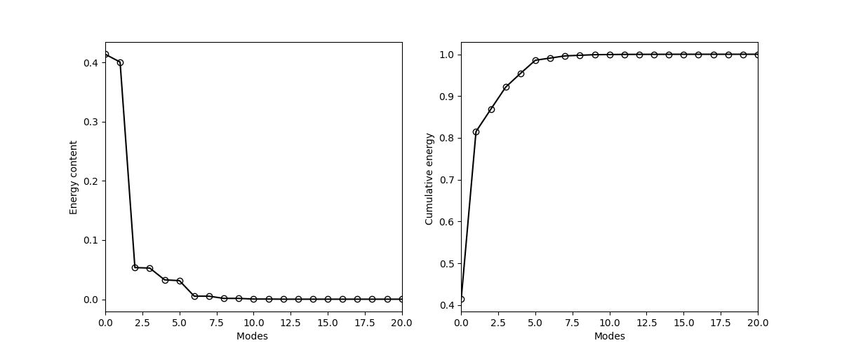
Energy graph

Slide 12
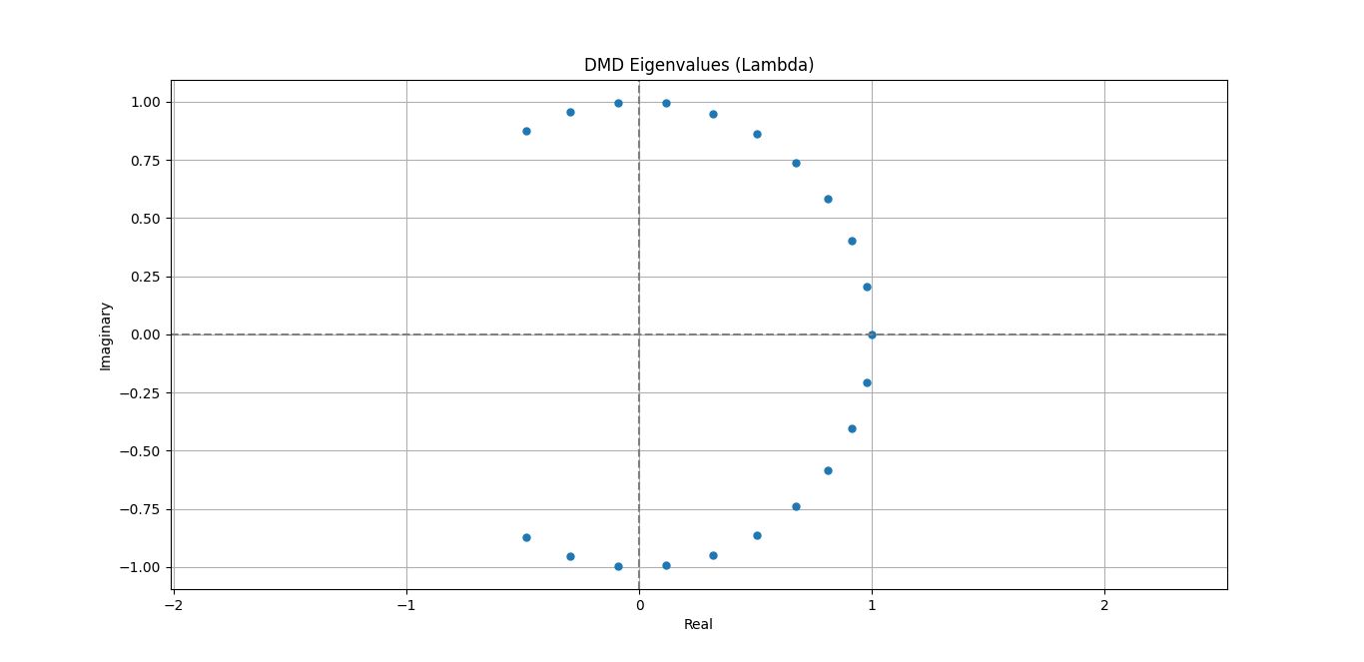
Eigen_Values

Slide 13
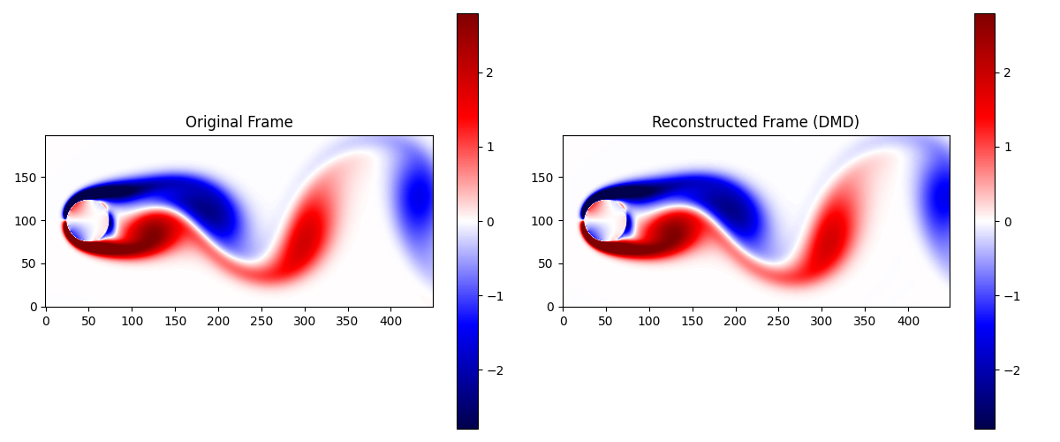
Original vs Reconstucted frame

Slide 14
THANK YOU

